Slide 1
NERSC Science Highlights A selection of science results produced by NERSC users
December, 2010

Slide 2
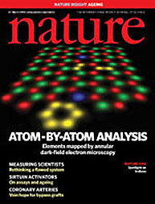
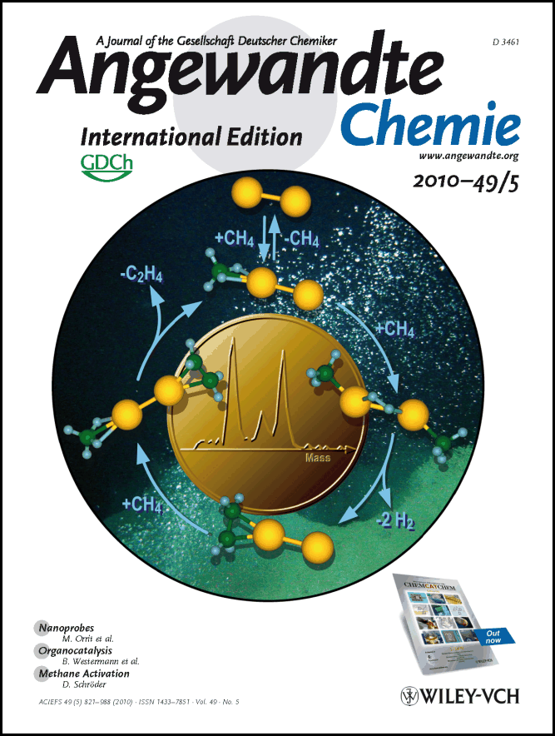
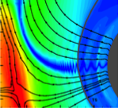
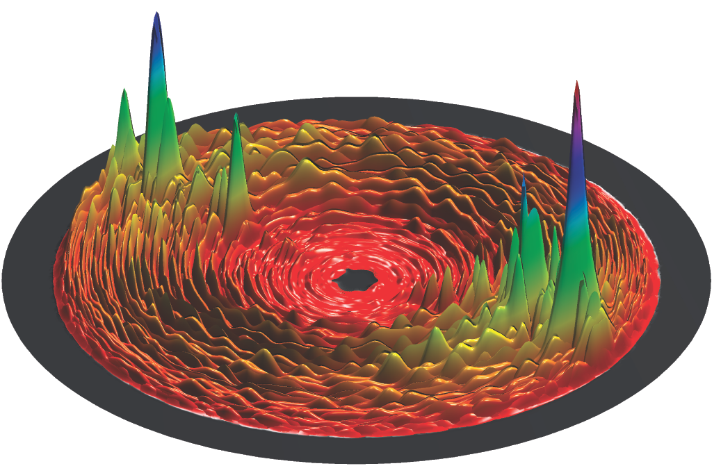
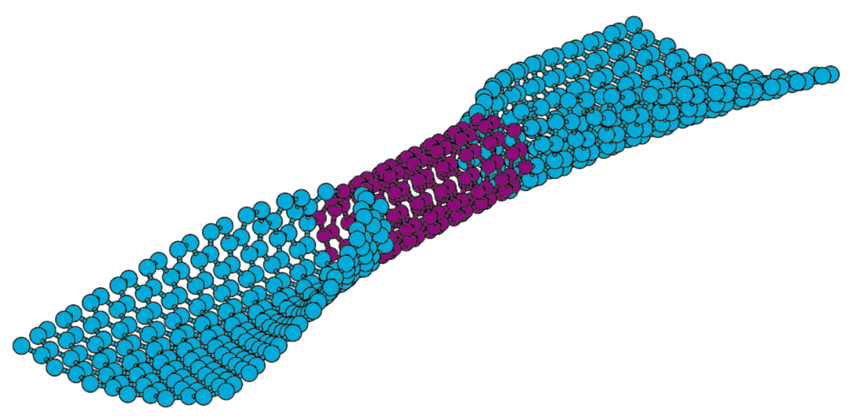
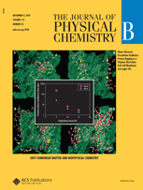
NERSC User Scientific Accomplishments December, 2010
Materials
Simulations done at NERSC helped validate key new experimental technique that allows researchers to “see” individual atoms (Pennycook, ORNL)
Energy Resources
First-principles simulations performed on Franklin revealed the mechanism of a full catalytic cycle for low-temperature activation of methane on small gold clusters.
(U. Landman, Georgia Tech)
Fusion Study by award-winning researcher explained magnetic reconnection phenomenon observed by Voyager spacecrafts.
(J. Drake, U. Maryland)
Chemistry Quantum dynamics of a reaction important to both combustion and ozone depletion were revealed using a newly parallel method developed at NERSC.
(H. Guo, Univ. of New Mexico)
Fuel Cells Simulations may lead the way toward rational design of polymer membranes, key components of fuel cells. (M. Dupuis, PNNL)
Low-Power Computing Quantum transport simulations may lead to discovery of nano-devices that can act as transistors.
(S. Salahuddin, UC Berkeley)
2

Slide 3
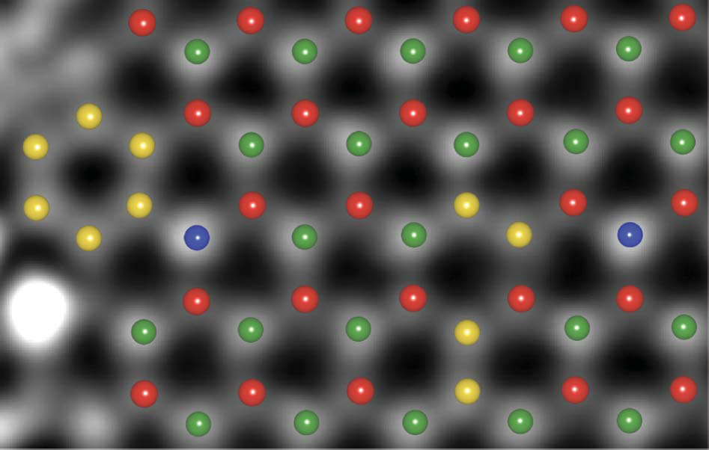
Simulation Helps Validate Key New Experimental Technique
Objective: Investigate atomic-scale structure of complex materials in conjunction with microscopy experiments.
Pantalides, Pennycook, et al.,(ORNL)
.
Implications: Combination of simulation and experiment represents a powerful means of uncovering material structure.
Accomplishments: New technique is the first where scientists can actually “see” individual atoms of boron, carbon and nitrogen.
Density Functional Theory (DFT) simulations (on Franklin) validated the results.
Helped bound the limit of the new technique.
The new high-resolution images will allow researchers to design more accurate simulations.
The atomic structure of a boron nitride monolayer as determined by DFT overlaid on part of the experimental image. Red, B; yellow, C; green, N; blue, O.
Nature, 25 March 2010 (cover story)
BES
Notes:
NERSC Repo pm221, Pennycook, Stephen is PI,
Numerical Simulations of Nanocrystals, Interfaces, Grain Boundaries in Complex Materials
Has used about 0.5M hours (plus about 0.3M cloud) in 2010; mostly on Hopper-1, average of about 4 nodes (32 cores) per run
Also written up in ScienceDaily Mar. 28, 2010 although NERSC was not mentioned.

Slide 4
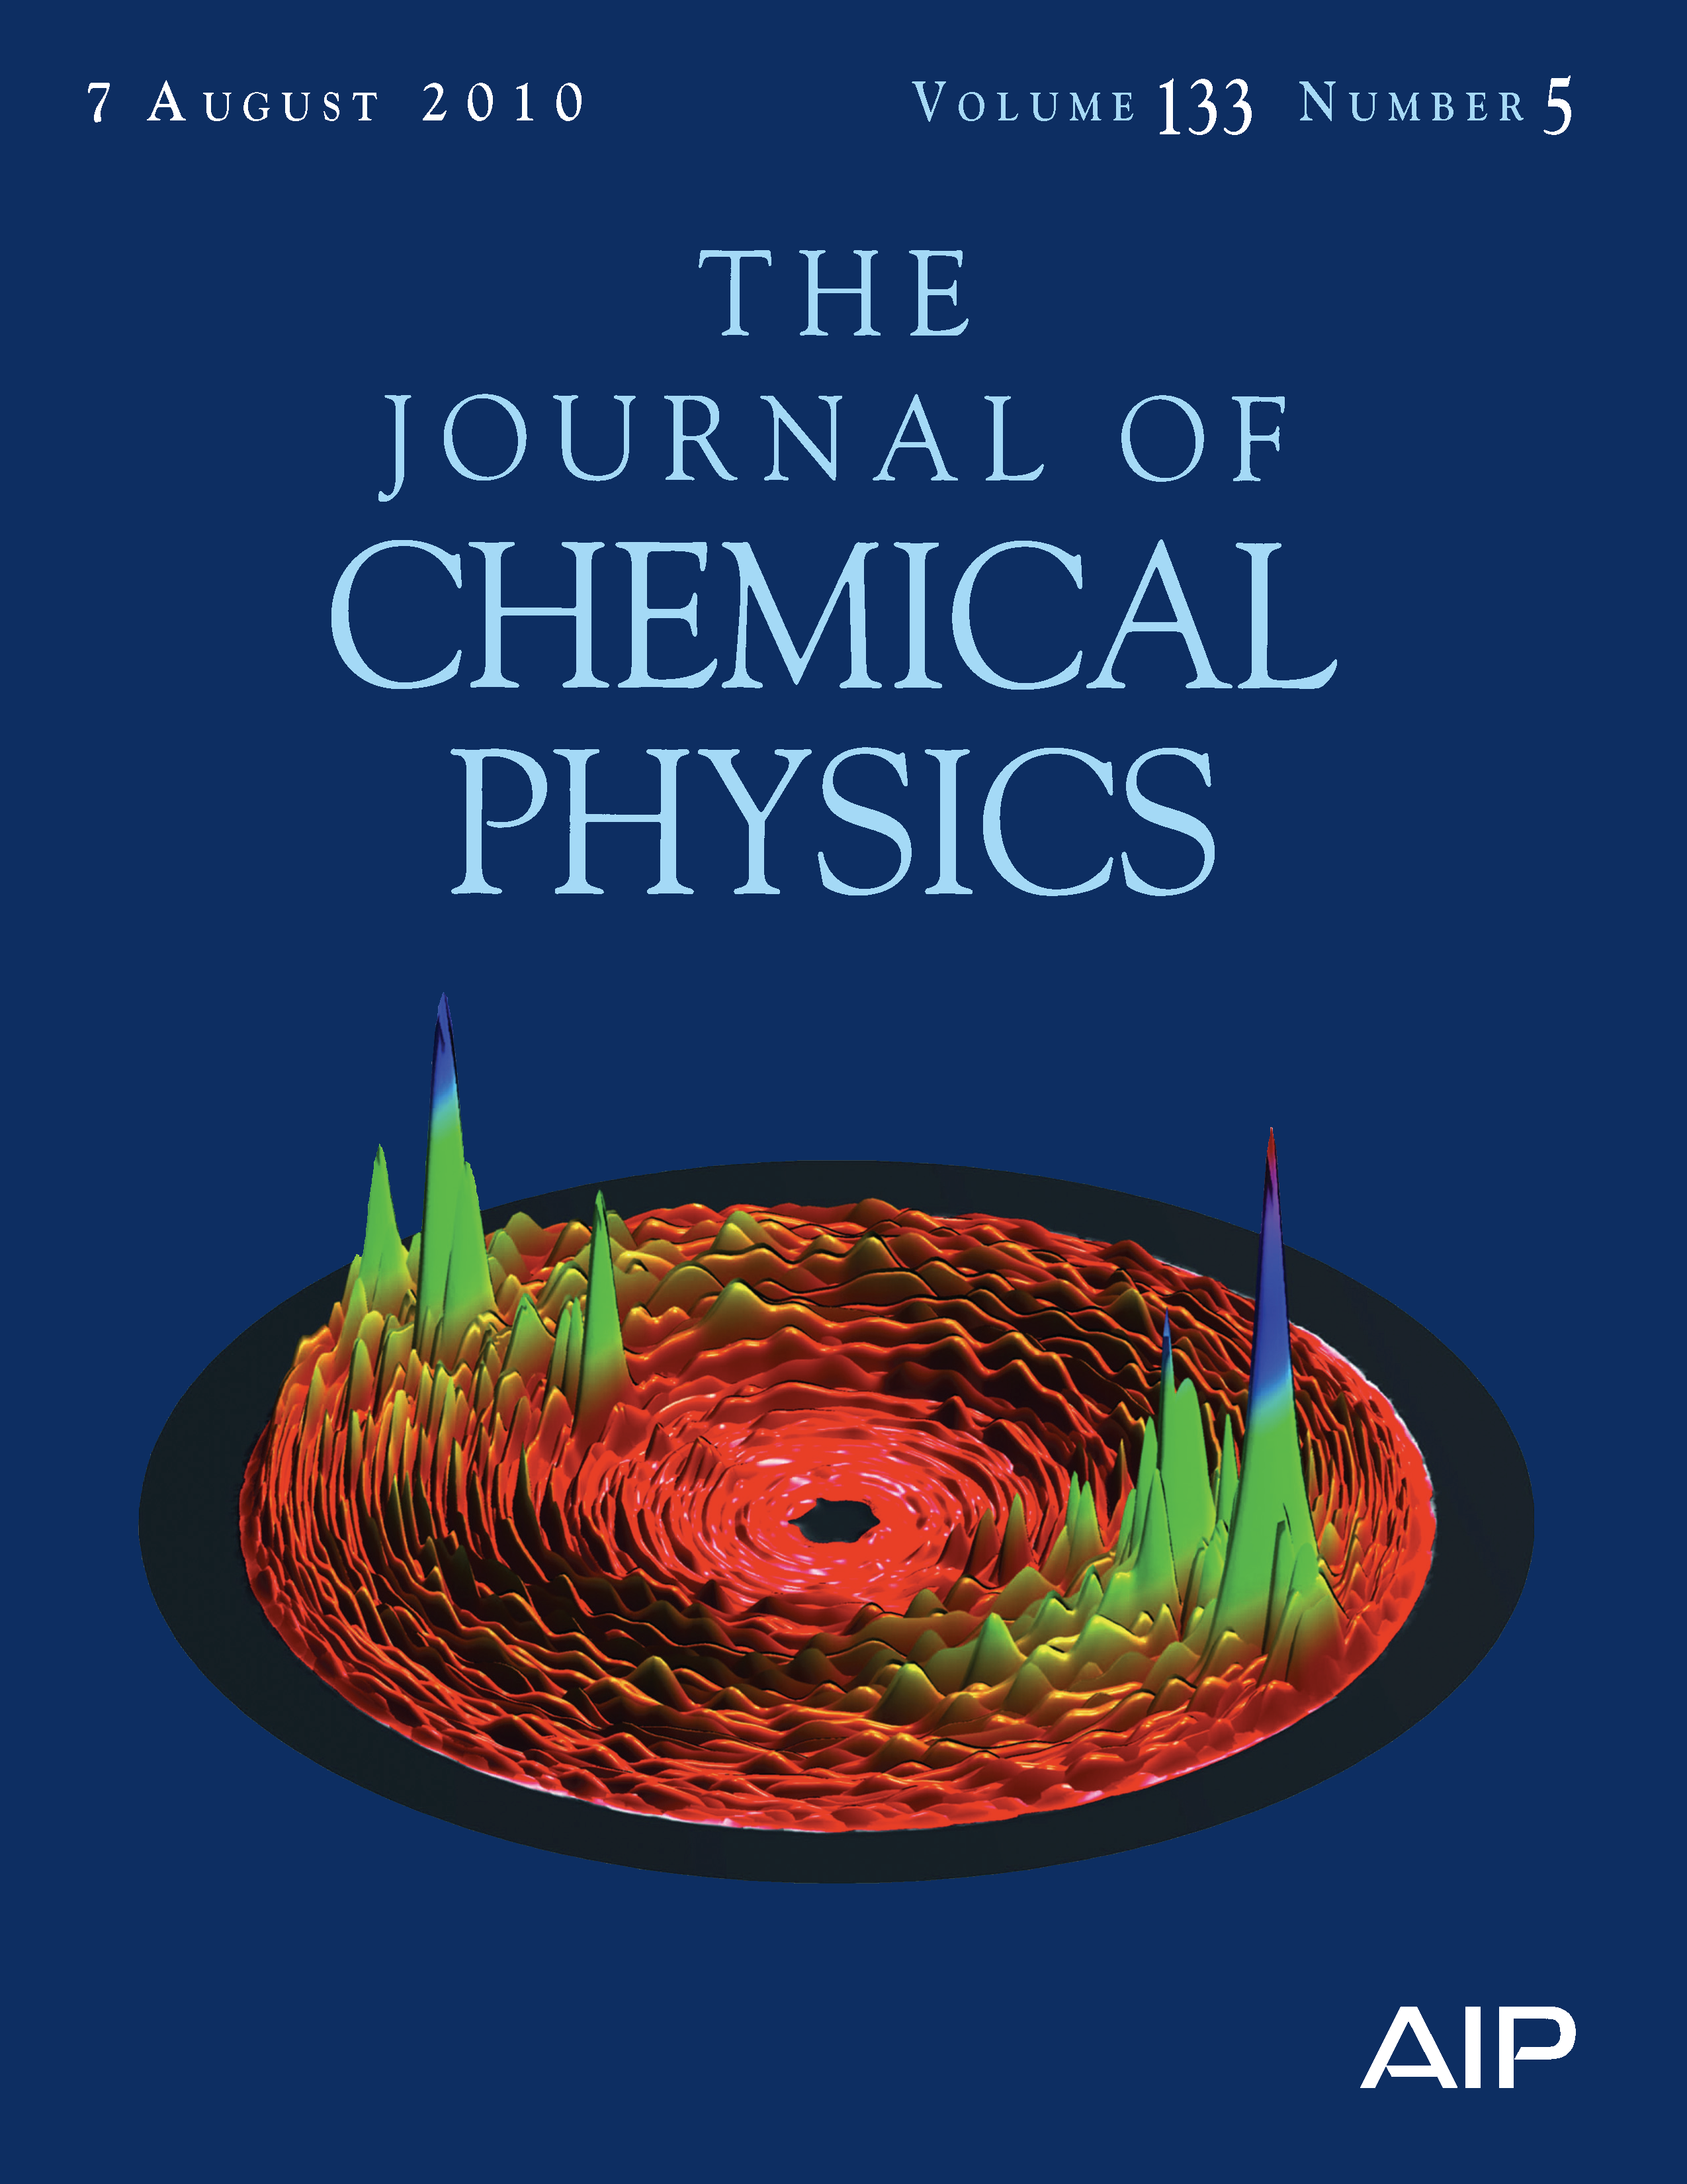
Quantum Dynamics Revealed
Objective: Study detailed quantum dynamics of elementary chemical reactions in the gas phase and on surfaces.
H. Guo (UNM)
.
Implications: These elementary reactions are often at the heart of important processes in combustion and catalysis.
The cover image shows a polar- coordinates plot of differential cross sections for the
O+OH reaction at 150meV of collision energy. The article was one of the top-20 most downloaded papers from this issue.
Accomplishments: Detailed calculations of O+OH➔H+O₂, which is the reverse of the most important combustion reaction and is also important for ozone destruction, shed light on long-standing questions about the statistical nature of the reaction dynamics.
Results will serve as a benchmark for more approximate treatments.
NERSC: Codes using OpenMP parallelism for calculating both total and differential cross sections were developed on Franklin and Hopper; NERSC NISE award, 2010
Journal of Chemical Physics 133, 054302, August 7, 2010
(cover story)
BES
Notes:
NERSC Repo m627, Quantum dynamics of elementary reactions in the gas phase and on surfaces
Frequently run with just one node on Hopper, up to 840 cores on Franklin, 400k MPP hours in 2010, total for repo.

Slide 5
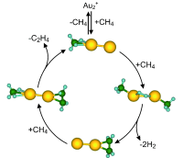
Nanocatalysis: “Small is Different”
Objective: Use quantum and classical simulation to investigate catalysis of methane reactions.
U. Landman, R. Barnett (GaTech)
Implications: Aid in conversion of methane into valuable chemical products and fuels.
.
Accomplishments: First-principles theoretical calculations played a leading role in discovering a full catalytic cycle for low-temperature activation of methane on free gold atoms.
Showed that small metal clusters adsorbed on support materials exhibit unique catalytic properties.
Demonstrated how to gain deep insights into complex chemical processes through coordinated state-of-the-art experimental and theoretical techniques.
Individual steps in a full catalytic cycle for methane (CH₄) conversion to ethylene (C₂H₄) on gold atoms discovered using first-principles theoretical studies on Franklin at NERSC
Angewandte Chemie International Edition
Vol 49 (5) 980–983,
January 25, 2010 (cover story)
NERSC: Accomplished with .ca 45,000 hours on Franklin using ~800 cores per job in 2009.
BES
Notes:
Nersc Repo mp97 Quantum and classical simulations of clusters, self-assembly. nano-scale manupulations, nanotribology, and biological processes; Landman is PI.
This repo used about 45,000 hours on Franklin during 2009, average of 200 nodes (800 cores) per job.

Slide 6
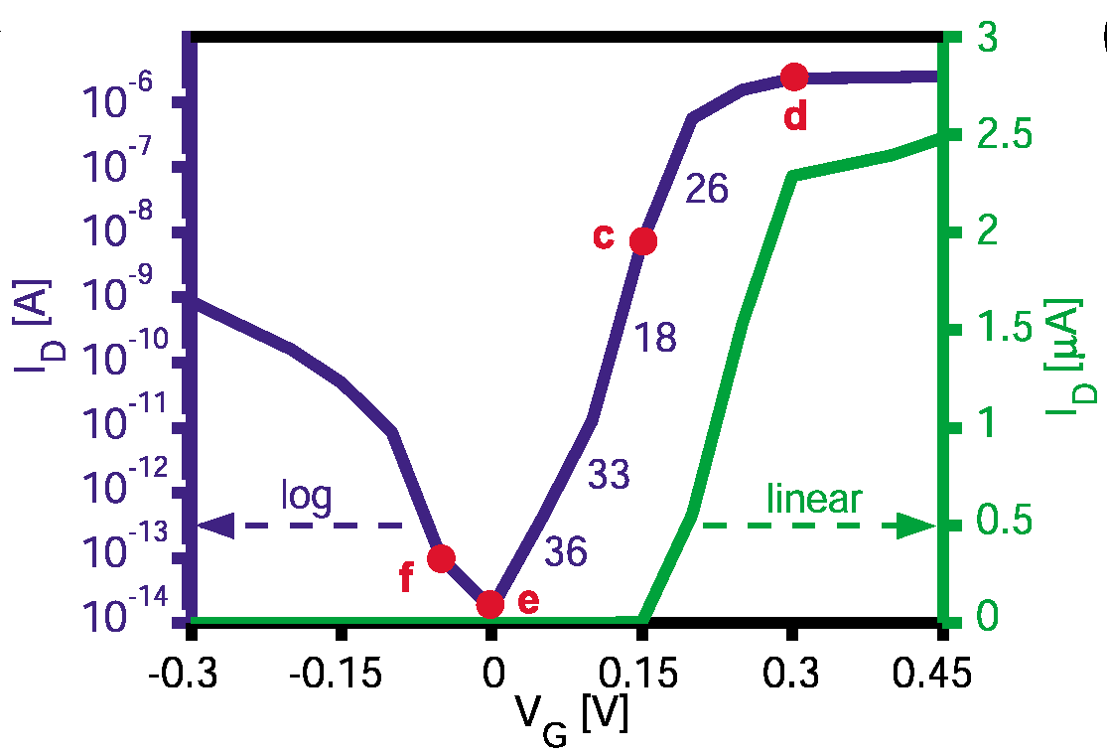
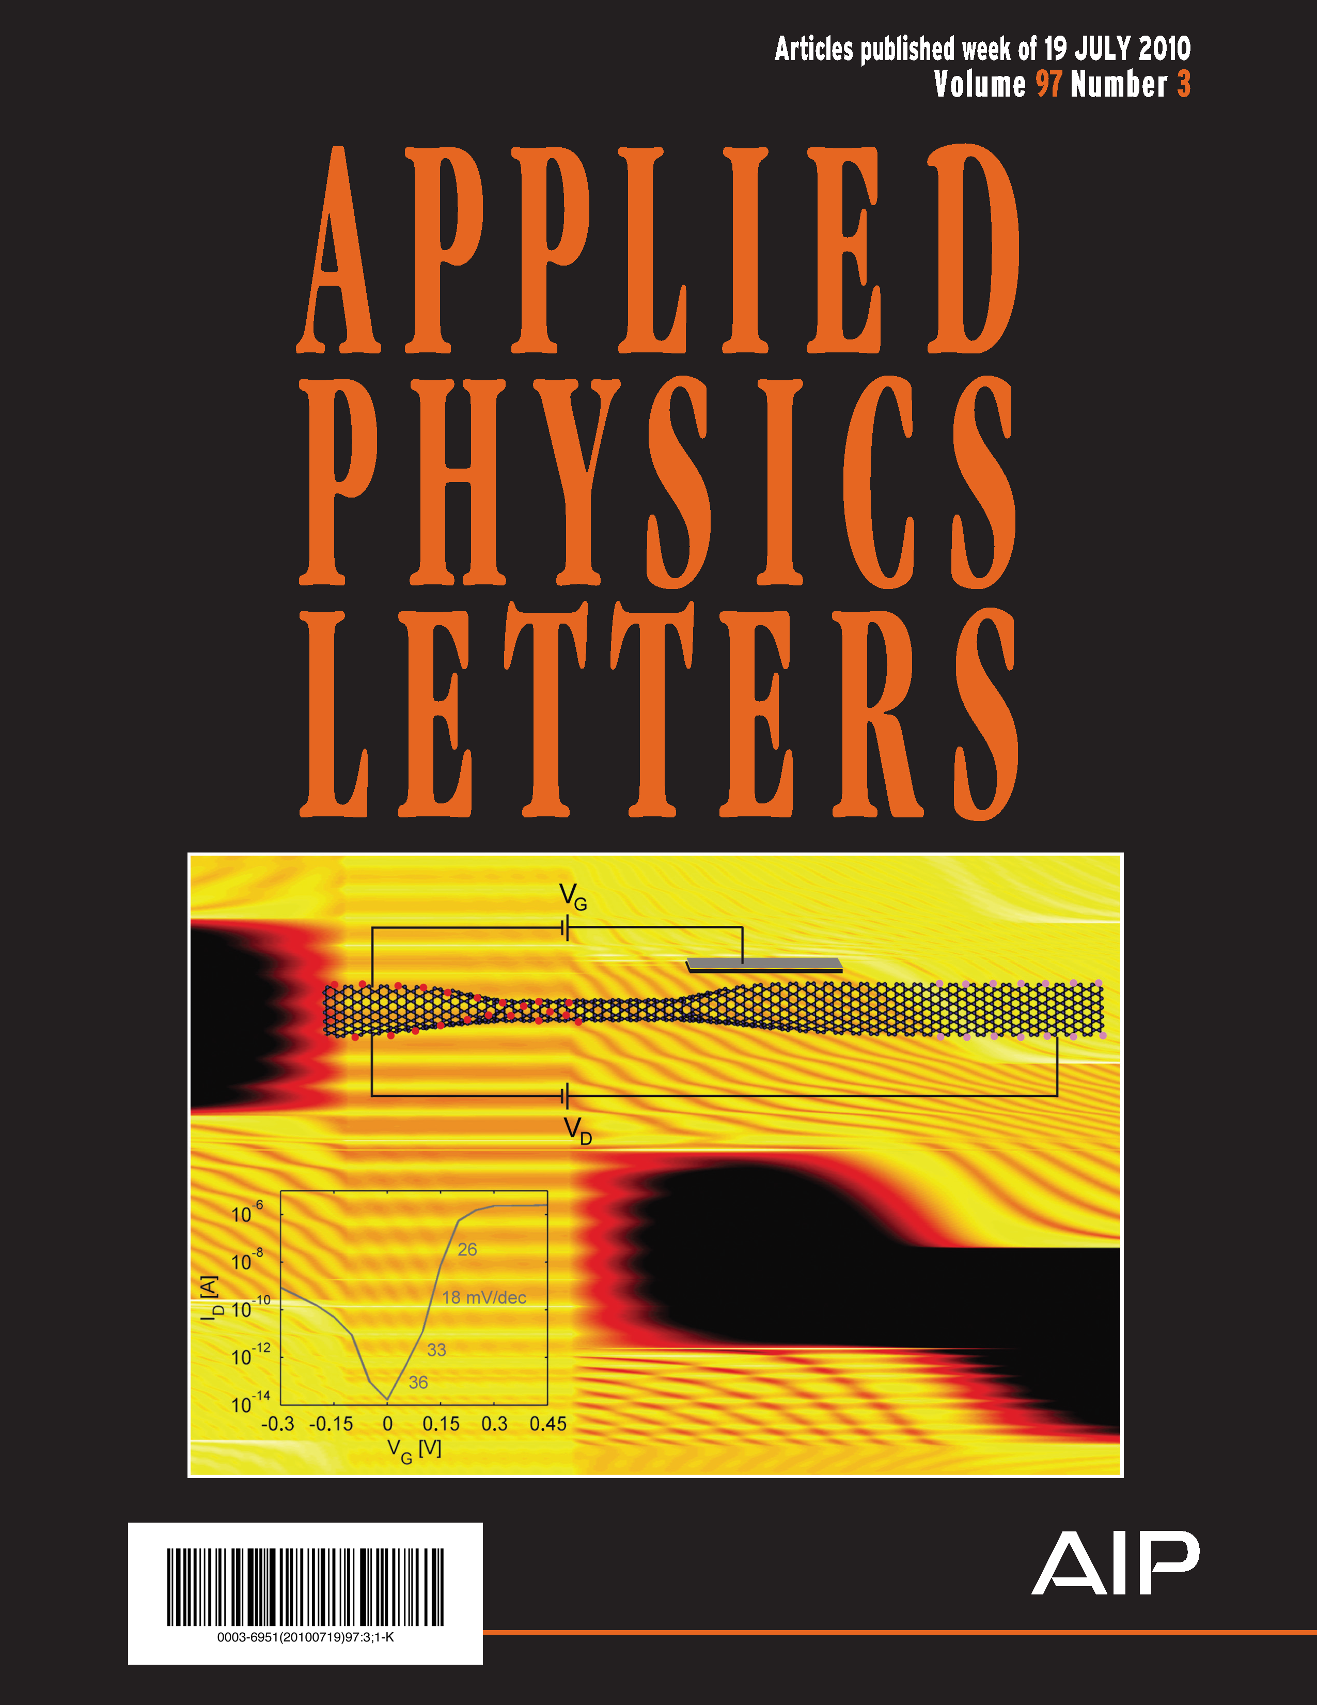
Ultra Low-Power Computing?
Objective: Simulate factors that affect nanoscale quantum transport.
Y. Yoon, S. Salahuddin (UCB)
Implications: May lead to discovery of nano-devices that can act as transistors, maintaining fast switching speeds but drastically reducing voltage requirements.
The unique carbon-based transistor junction created by joining a nanoribbon (blue) with a nanotube (purple).
Accomplishments: Simulations showed that the interface between a graphene nanoribbon and a carbon nanotube results in a unique transistor structure.
The device acts like a tunneling transistor at low voltages but allows a large “on” current at high voltages.
Simulation results showing that electric current (purple line) increases by 4 orders of magnitude with a change in voltage of only 100 mV.
NERSC: Work done mostly on Jacquard using a small allocation (15k hours) in 2009. NISE award in 2010 is enabling a custom electronic transport code to scale to 8,000+ cores along with application to new areas.
Appl. Phys. Lett. 97, July 19,2010, 033102
(cover story)
Notes:
NERSC Repo mp946, Massively parallel quantum transport simulation of nano scale electronic devices for ultra low power computing
Not supported by Office of Science
Principal Investigator Salahuddin
175 jobs, all on Franklin, 270k hours, mostly 240 cores each

Slide 7
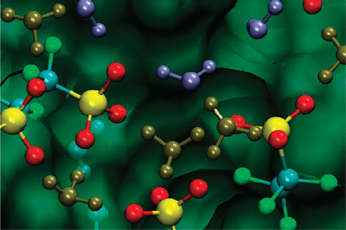
Designing Fuel Cell Membranes
Objective: Fundamental understanding of proton transport to enable rational design of fuel cell membranes.
R. Davanathan, M. Dupuis, et al. (PNNL)
Implications: Membranes are key fuel cell components: they conduct charge while separating the fuel cell reactants. But no existing membrane exhibits all properties necessary for widespread use.
A portion of the membrane simulated, showing water, hydronium ion, and different parts of the Nafion polymer.
Accomplishments: Performed classical and quantum simulations of the common membrane “Nafion” as a function of hydration level.
Showed how water percolation affects proton hopping across the membrane and quantified hydration level to achieve it.
Results could lead to design of future polymer membrane materials that have lower uptake of water and yet offer faster proton transfer and transport.
J. Phys. Chem. B, 114, 13681–13690, November 4, 2010 (cover story)
BES
Notes:
NERSC Repo m544, Charge Transfer, Transport, and Reactivity in Complex Environments.
Principal Investigator Dupuis
In 2009 and 2010 this repo ran on Jacquard, Bassi, and Franklin; This work looks like it was done on Franklin, typically 64-256 cores;
Work was also done at EMSL at PNL.

Slide 8
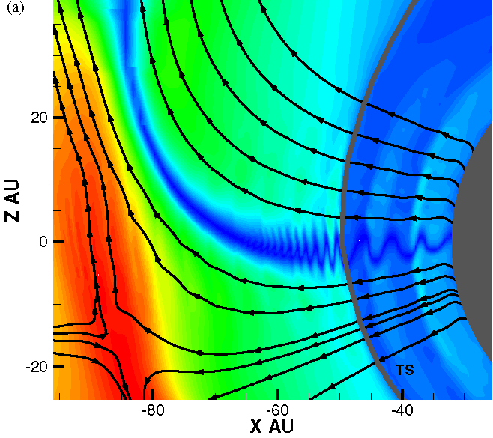
Magnetic Reconnection and Anomalous Cosmic Rays
Objective: Complete understanding of reconnection: how magnetic fields change topology and convert magnetic energy to kinetic and thermal energy.
J. F. Drake, et al. (U. Maryland)
Implications: Has broad importance in space (e.g. solar flares), astrophysics, and fusion experiment plasmas.
Accomplishments: Provided explanation for surprising Voyager 1 & 2 spacecraft observation of Anomalous Cosmic Rays (ACRs: ions with energies just below galactic cosmic rays).
Required both magnetohydrodynamic (MHD) and particle-in-cell (PIC) methods.
Drake is 2010 winner of APS Maxwell Award for Plasma Physics.
2-D view of the magnetic field and flow streamlines from a high-resolution, 3-dimensional MHD simulation of the interaction of the solar wind with the interstellar medium, interplanetary and interstellar magnetic field, and ionized and neutral H atoms.
NERSC: Simulations use 1,024-8,192 cores (Franklin).
The Astrophysical Journal (APS) 709:963–974, February 1, 2010
BES
Notes:
NERSC Repo mp217, Turbulence, Transport and Magnetic Reconnection in High Temperature Plasma
Principal Investigator: Bill Dorland (U Maryland) During 2009 the repo ran 6,000 jobs on bassi and Franklin, using up to 8,192 cores on Franklin and most commonly using 1,024-2,048 (1.8M hours total)

Slide 9
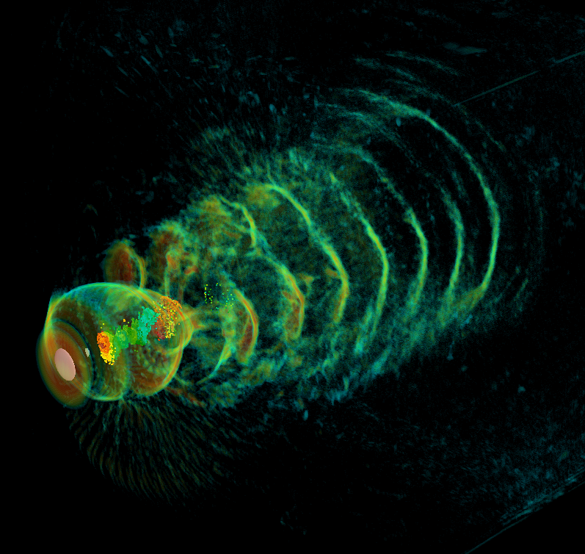
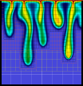
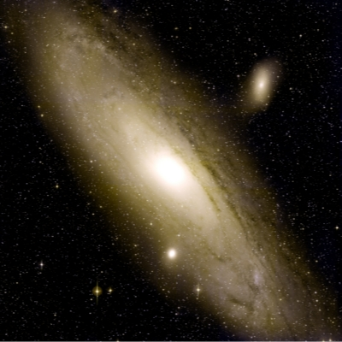
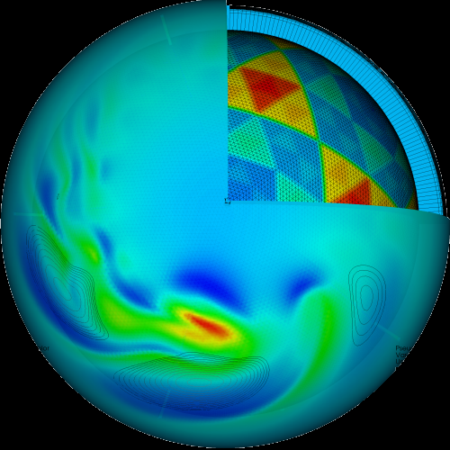
About the Cover Images
Low swirl burner combustion simulation. Image shows flame radical, OH (purple surface and cutaway) and volume rendering (gray) of vortical structures. Red indicates vigorous burning of lean hydrogen fuel; shows cellular burning characteristic of thermodiffusively unstable fuel. Simulated using an adaptive projection code. Image courtesy of John Bell, LBNL.
Hydrogen plasma density wake produced by an intense, right-to-left laser pulse. Volume rendering of current density and particles (colored by momentum orange - high, cyan - low) trapped in the plasma wake driven by laser pulse (marked by the white disk) radiation pressure. 3-D, 3,500 Franklin-core, 36-hour LOASIS experiment simulation using VORPAL by Cameron Geddes, LBNL. Image courtesy of Cameron Geddes..
Numerical study of density driven flow for CO₂ storage in saline aquifers. Snapshot of CO₂ concentration after convection starts. Density-driven velocity field dynamics induces convective fingers that enhance the rate by which CO₂ is converted into negatively buoyant aqueous phase, thereby improving the security of CO₂ storage. Image courtesy of George Pau, LBNL
False-color image of the Andromeda Galaxy created by layering 400 individual images captured by the Palomar Transient Factory (PFT) camera in February 2009. NERSC systems analyzing the PTF data are capable of discovering cosmic transients in real time. Image courtesy of Peter Nugent, LBNL.
The exciton wave function (the white isosurface) at the interface of a ZnS/ZnO nanorod. Simulations performed on a Cray XT4 at NERSC, also shown. Image courtesy of Lin-Wang Wang, LBNL.
Simulation of a global cloud resolving model (GCRM). This image is a composite plot showing several variables: wind velocity (surface pseudocolor plot), pressure (b/w contour lines), and a cut-away view of the geodesic grid. Image courtesy of Professor David Randall, Colorado State University.

